Slide 1

Organizational Structure & Behaviour
Group Members
MUHAMMAD ALI HAIDER
MUHAMMAD FAHAD
NIDA PERVAIZ KHAN
MEHNAZ MUKHTIAR KHAN

Slide 2
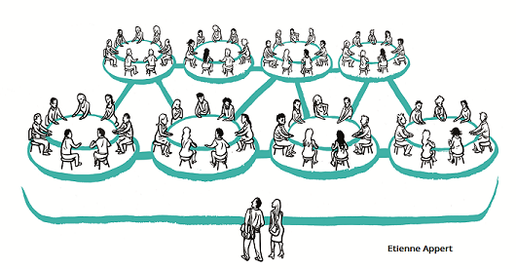
AGENDA
About Organization
Strategic Planning
Human Resource Management
Training
Current Operations

Slide 3

ABOUT ORGANIZATION
Introduction
Break Thru is a fast growing, emerging new age technology and services company that is committed to providing you with the best industry experiences.

Slide 4

ABOUT ORGANIZATION
History
We started with 4 people in 2008, in 2015 we had staff having 100 to 120 people in it. Today in 2021 we have more than 300 people in staff, to manage these we have multiple departments for specific jobs.

Slide 5

ABOUT ORGANIZATION
Vision
“
The vision is to address the needs of the market by forming what could be considered a utility for information technology.
“

Slide 6

ABOUT ORGANIZATION
Departments
These are the following departments of BreakThru
Training & Development
Quality Assurance
Developers
Fresh Desk
SDR
Operations
Finance

Slide 7

ABOUT ORGANIZATION
Social Connections
LinkedIn:
is used as because the majority of our corporate achievements are on LinkedIn.
Facebook:
like in-house activities are marketed on Facebook.
Instagram:
Employee’s engagement are promoted as pictures on Instagram.

Slide 8




ABOUT ORGANIZATION
Competitors

Slide 9
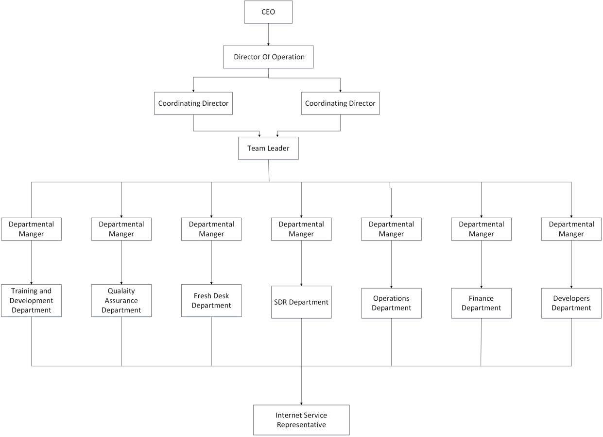
Organizational Structure

Slide 10

Strategic Planning
Key Factors:
International market
Clients Services
Tracking and Management
Data Collection
Different connected services

Slide 11

STRATEGIC PLANNING
Marketing Strategies
Social Networking
US Marketing
Future Expectations
Rising Factors
Market stand
Key Factors
International market
Clients Services
Tracking and Management
Data Collection
Different connected services

Slide 12

HUMAN RESOURCE MANAGEMENT (HRM)
Recruitment Process for Employees
Conducts Test (essay, passages, typing)
Interviews (two)
Estimate Number of Employees
Office in Pakistan
300 employees
In different departments

Slide 13

HUMAN RESOURCE MANAGEMENT
Employees Performance Evaluation Criteria
Quarterly evaluations
ISR (Internet Service Representatives)
Performance measuring parameters
Benefits fluctuate on quarterly basis
Future Plans For Employees
Monthly basis internal job positions
Shifts to the career field
Promoted almost 18 positions
Same hiring process

Slide 14

HUMAN RESOURCE MANAGEMENT
Controlling Processes
Only quality
In 2008, 1 chat in 35 min to 45 min
Now, 4 to 5 chat per person
Management During Covid
Faced some problems
Later everyone cooperated

Slide 15

TRAINING
Training Methods and Key Factors
Basic training - 2 weeks
On floor under supervision - 2 weeks
Customer Support
Covid Outbreak
Restrained from training
Hold the hiring

Slide 16

TRAINING
Training Duration
Brief training
Probation Period
Factors of Demotivation and Handling
Motivating Strategies
Counselling sessions

Slide 17
TRAINING
Trainers and their responsibilities
Assigned agents
At initial level
Service Of Operations
Never turn a customer away
8 SOPS
Business Expansion and training
Priority matters
Changes in Ideology and Adoption
Capable employees
Training as a helping hand

Slide 18
CURRENT OPERATIONS
Work as it is Today
The growing team
A pathway to a better customer experience world

Slide 19
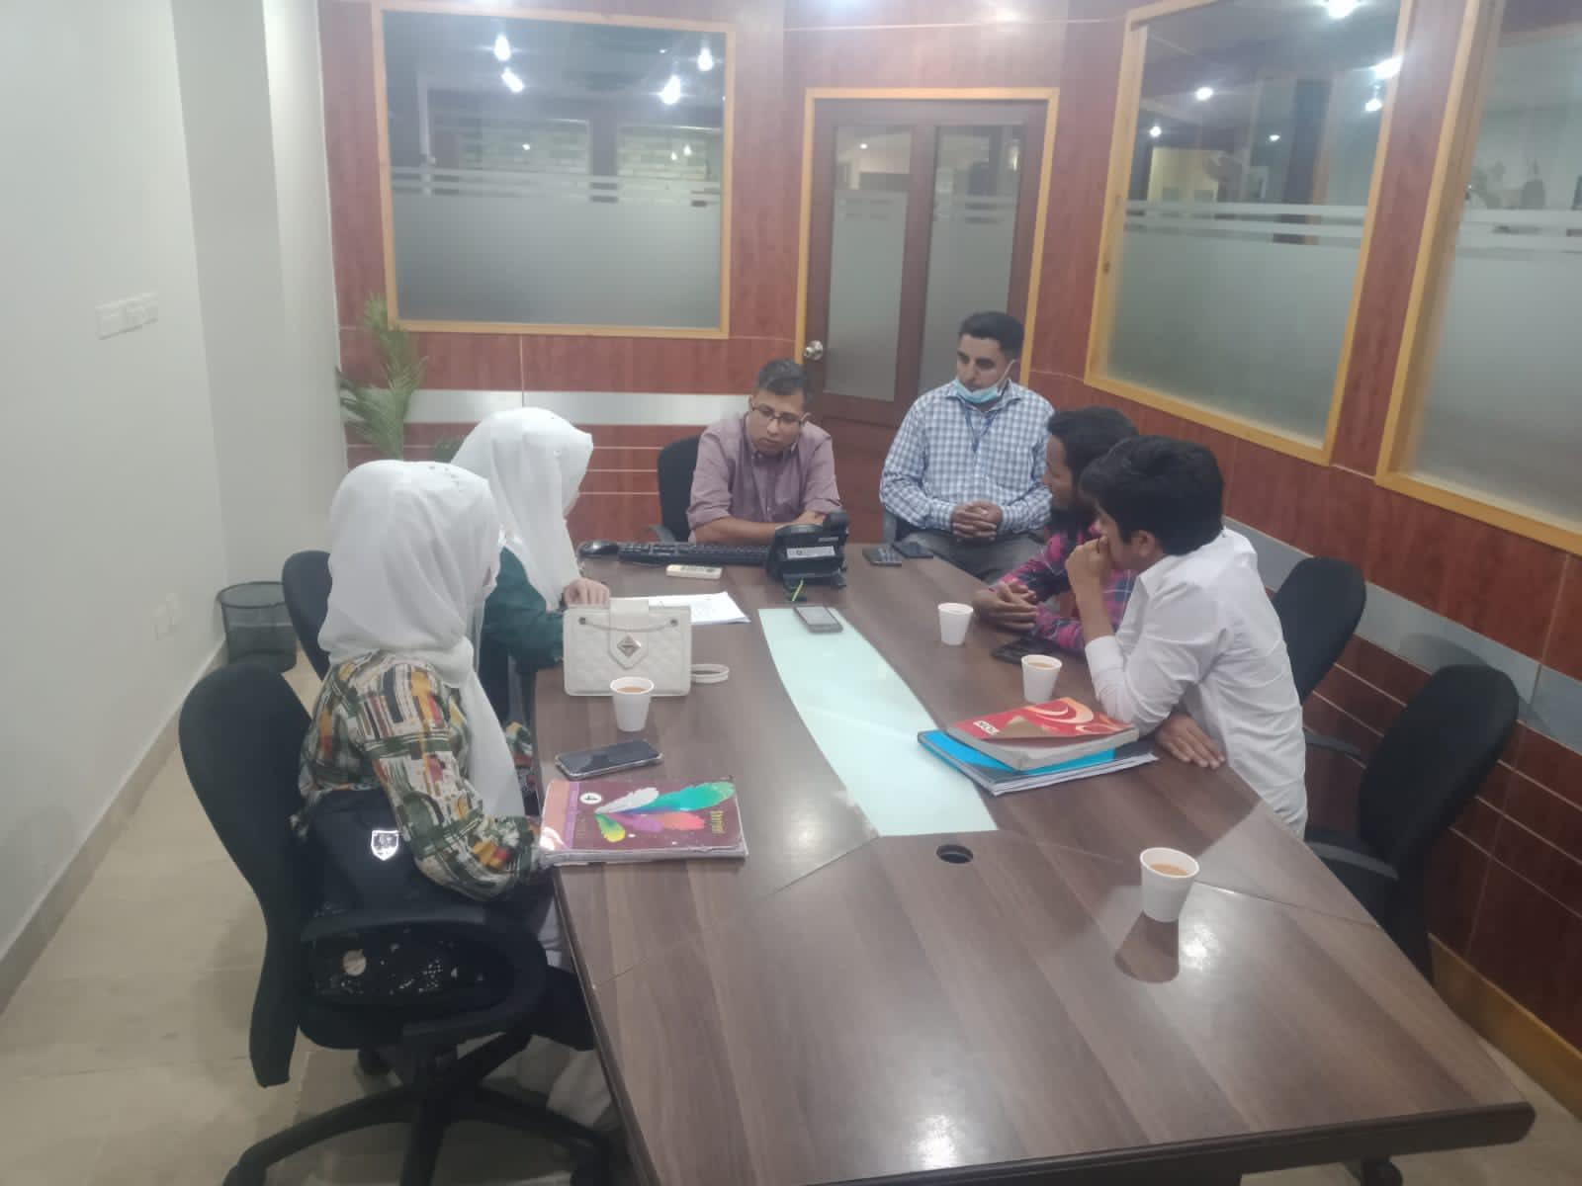
Team with Director. Mr Talha Mohsin

Slide 20
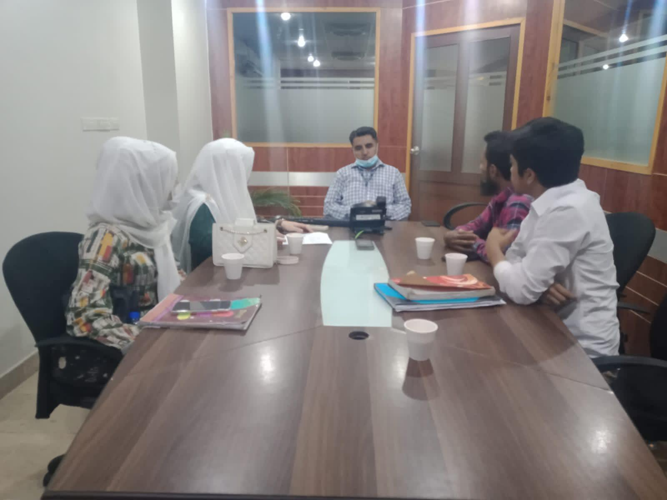
Team with Team Leader. Mr Ghulam Mujtaba

Slide 21
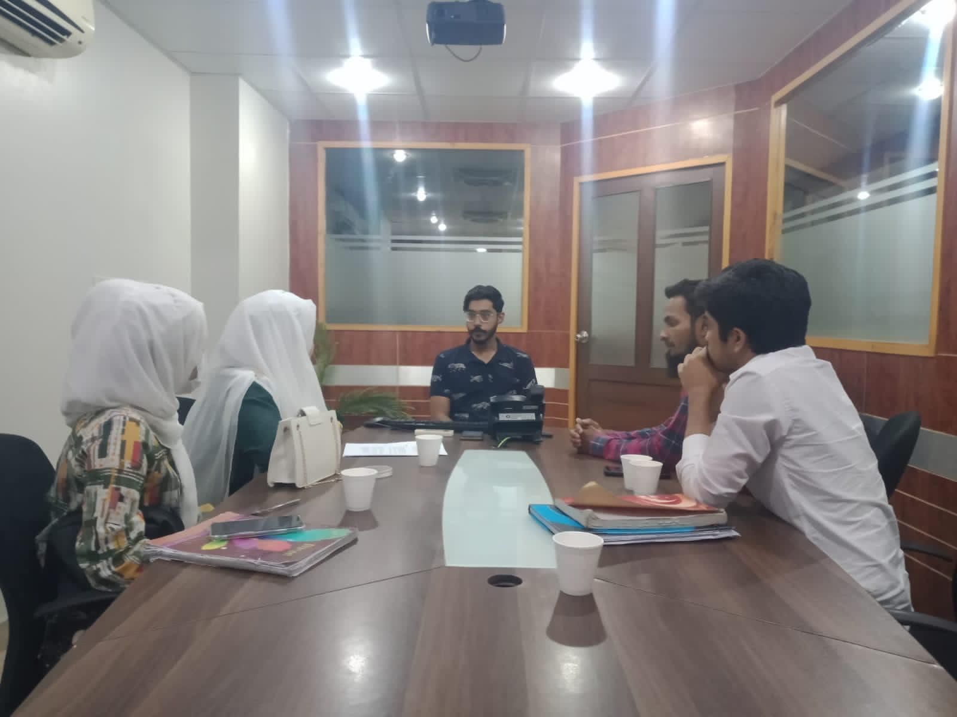
Team with HR. Mr Saif Ullah

Slide 22
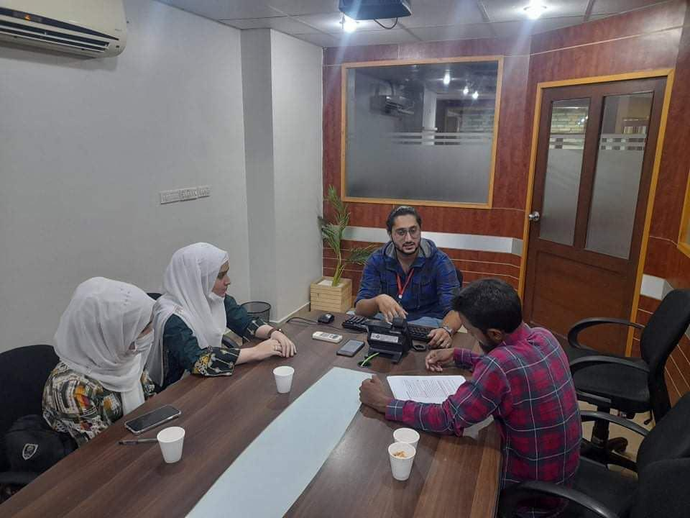
Team with Trainer. Mr Shahrukh Ali Noor

Slide 23
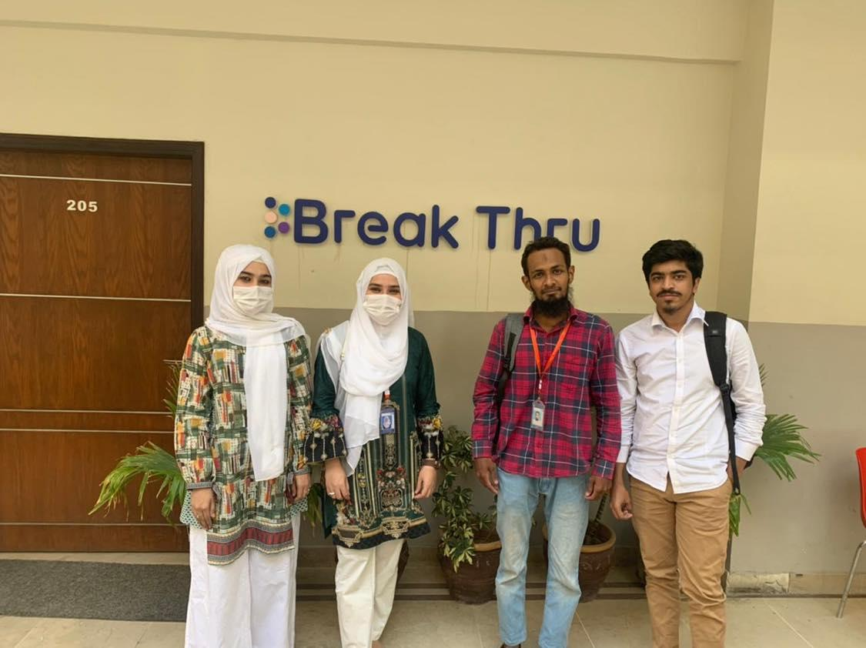
MEETING PICTURES
TEAM

Slide 24
How we worked ?

Slide 25
Questions ?

Slide 26

Thank
You!

